Slide 1
Object-oriented Testing

Slide 2
Objectives
Object oriented testing associated with
  Analysis and Design Testing
  Class Tests
  Integration Tests
  System Tests
  Validation Tests

Slide 3
A Strategy for Testing Conventional Software
Acceptance Testing
Narrow to
Broader scope
System Testing
Integration Testing
Unit Testing
Code
Abstract to
concrete
Design
Requirements
End user’s Needs

Slide 4
Object-oriented Testing
When should testing begin?
Analysis and Design:
  Testing begins by evaluating the OOA and OOD models
  How do we test OOA models (requirements and use cases)?
  How do we test OOD models (class and sequence diagrams)?
  Structured walk-throughs, prototypes
  Formal reviews of correctness, completeness and consistency
Programming:
  Concept of a ‘unit’ broadens due to class encapsulation
  Integration focuses on classes and their context of a use case scenario or their execution across a thread
  System/Validation may still use conventional black box methods

Slide 5
Testing OO Code
Integration
tests
Class tests
System
tests
Validation
tests

Slide 6
Object-oriented Testing Strategies
Unit Testing
  Smallest testable unit is the encapsulated class or object
  Driven by class operations and state behavior, not algorithmic detail and data flow across module interface
  We can no longer test a single operation in isolation (the conventional view of unit testing) but rather, as part of a class.
  Consider a class hierarchy in which an operation X() is defined for the super class and is inherited by a number of subclasses. Each subclass uses operation X(), but it is applied within the context of the private attributes and operations that have been defined for each subclass.
  Because the context in which operation X() is used varies in subtle ways, it is necessary to test operation X() in the context of each of the subclasses. This means that testing operation X() in a vacuum (the traditional unit-testing approach) is ineffective in the object-oriented context.

Slide 7
Object-oriented Testing Strategies
Integration Testing
  Integration of operations one at a time into a class is often meaningless
    Because of direct and indirect interaction of components
  Focuses on groups of classes that collaborate in some manner
  Thread-based testing
    Testing/integrate the set of classes required to respond to one input or event
  Use-based testing (integrates classes required by one use case)
    Begins by testing independent classes that use very few of server classes
    Next layer of classes (dependent classes) that use the independent classes are tested next
  Cluster testing
    Groups of collaborating classes are tested for interaction errors
  Regression testing is important as each thread, cluster or subsystem is added to the system

Slide 8
Object-oriented Testing Strategies
System Testing
  Are we building the product right?
  Recovery testing: how well and quickly does the system recover from faults
  Security testing: verify that protection mechanisms built into the system will protect from unauthorized access (hackers, disgruntled employees, fraudsters)
  Stress testing: place abnormal load on the system
  Performance testing: investigate the run-time performance within the context of an integrated system

Slide 9
Object-oriented Testing Strategies
Validation Testing
  Are we building the right product?
  Details of class connection disappears.
  Validation succeeds when software functions in a manner that can be reasonably expected by the customer.
  Focuses on visible user actions and user recognizable outputs
  Validation tests are based on the use-case scenarios, the object behavior model, and the event flow diagram
Apply:
  Use-case scenarios from the software requirements spec
  Black-box testing to create a deficiency list
  Acceptance tests through alpha (at developer’s site) and beta (at customer’s site) testing with actual customers

Slide 10
Test Case Design
Each test case should be uniquely identified and be explicitly associated with a class to be tested
the purpose of the test should be stated
A list of testing steps should be developed for each test
OO testing focuses on designing appropriate sequences of operations

Slide 11
Testing Methods: Class Level
Random Testing : requires large number of data permutation and combination
    Identify operations applicable to a class
    Define constraints on their use– e.g. the class must always be initialized first
    Identify a minimum test sequence – an operation sequence that defines the minimum life history of the class
    Generate a variety of random test sequences– this exercises more complex class instance life histories

Slide 12
Testing Methods:Class Level
Example of Random Testing
1) consider an account class that has the following operations:
open, setup, deposit, withdrawal, balance, summarize, credit Limit, close
2) The account must be opened first and closed on completion
Minimum behavioral life history of account may occur: open•setup•deposit•withdrawal•close

Slide 13
Testing Methods: Class Level
Example of Random Testing
3) a variety of behaviors may occur:
open•setup•deposit•[deposit | withdrawal | balance| summarize | credit limit]^{n}•withdrawal•close
4) different operation sequences can be generated randomly:
test case #1: open•setup•deposit•deposit• balance• summarize•
withdrawal•close
test case #2: open•setup•deposit•withdrawal• deposit• balance•
credit limit•withdrawal•close
These and other random order tests are conducted to exercise different class instance life histories.

Slide 14
Testing Methods: Class Level
Partition Testing: reduces the number of test cases required to test a class
State-based partitioning
  Categorizes class operations based on their ability to change the state of the class
  Tests designed in way so that operations that cause state changes and those that do not change state are tested separately
  Example:
  Test case #sp1: open• setup• deposit• deposit• withdrawal• withdrawal• close
  Test case #sp2: open• setup•summarize • credit limit• close

Slide 15
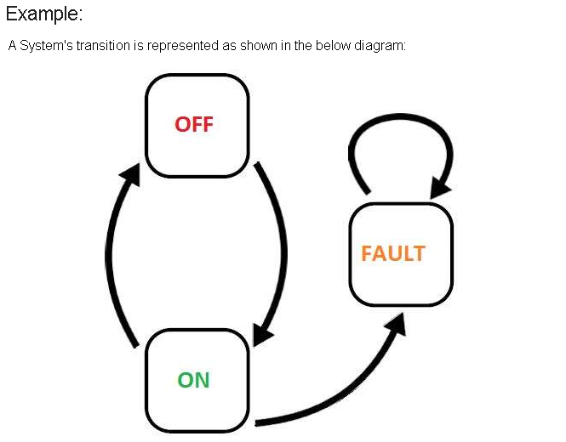


Slide 16
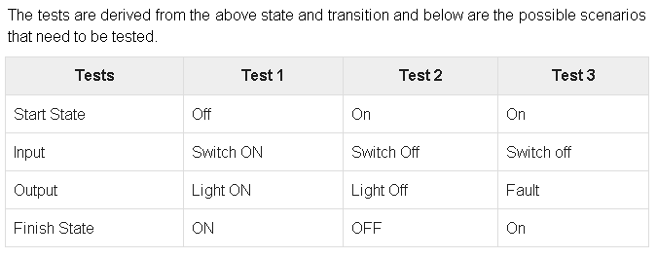

Slide 17
Testing Methods:Class Level
Attribute-based partitioning
  Categorizes class operations based on the attributes that they use and modify
  Tests designed in way so that operations that use or modify attributes are tested separately from those that do not use or modify attributes
  Example:
  for the account class, the attributes balance and credit limit can be used to define operations. Operations are divided into three partitions:
  1) operations that use credit limit
  2) operations that modify credit limit
  3) operations that do not use of modify credit limit

Slide 18
Testing Methods: Class Level
Category-based partitioning
  Categorizes class operations based on the generic function that each performs such as initialization, computation, query, termination
  Example:
  operations in the account class can be categorized as:
  1) initialization (open, setup)
  2) computation (deposit, withdraw)
  3) queries (balance, summarize, credit limit)
  4) termination (close)

Slide 19
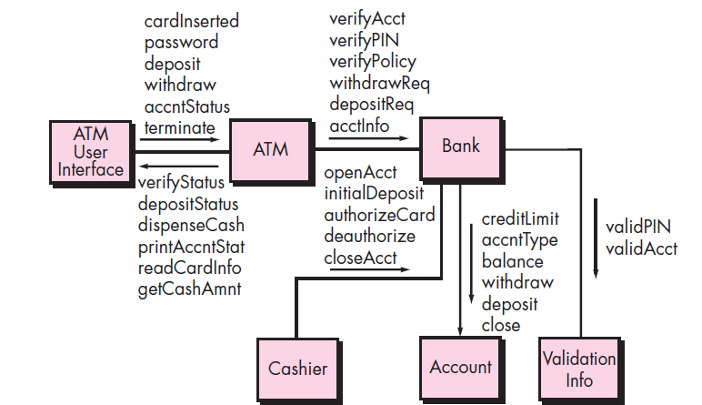
Interclass: Test Case Design
Test case design becomes more complicated as integration of the OO system begins – testing of collaboration between classes

Slide 20
Interclass: Test Case Design
Multiple class testing
  For each client class, use the list of class operators to generate a series of random test sequences that send messages to other server classes
  For each message generated, determine the collaborator class and the corresponding operator in the server object
  For each operator in the server object (invoked by a client object message), determine the message that it transmits
  For each of the message, determine the next level of operators that are invoked and incorporate these into the test sequence.

Slide 21
Interclass: Test Case Design
Multiple class testing : example
  Consider a sequence of operations for the bank class relative to an ATM class:
  verifyAcct•verifyPin•[[verifyPolicy•withdrawReq]|depositReq| AcctInfoReq]^{n}
  A random test case for the bank class might be
  Test case #r3: verifyAcct•verifyPin• depositReq
  The collaborators invoked for the above test case are ValidationInfo to execute verifyAcct and verifyPin. Collaborate with Account to execute depositReq
  Thus a new test case that exercise these collaborations is
  Test case #r4: verifyAcct[Bank:validAcctValidationInfo]•verifyPin[Bank:ValidPinValidationInfo]•depositReq[bank:depositAccount]

Slide 22
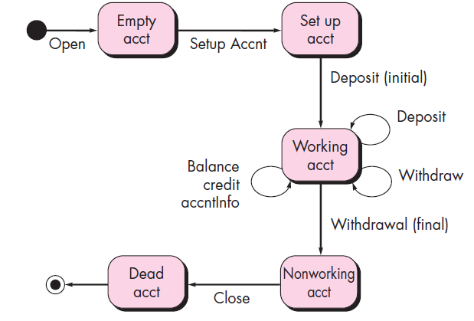
Interclass: Test Case Design
Test derived from behavior models
  Use the state transition diagram as a model
  Test cases must cover all states
  Dynamic behavior of class

Slide 23
Interclass: Test Case Design
The tests to be designed should achieve coverage of every state. That is, the operation sequences should cause the Account class to make transition through all allowable states:
Test case s1:
open•setupAccnt•deposit (initial)•withdraw (final)•close
Noted that this sequence is identical to the minimum test sequence
Adding additional test sequences to the minimum sequence,
Test case s2:
open•setupAccnt•deposit(initial)•deposit•balance• credit•withdraw (final)•close
Test case s3: open•setupAccnt•deposit(initial)•deposit•withdraw•accntInfo•withdraw (final)•close

Slide 24
System Testing
System testing: – verifies that all system elements mesh properly and that overall system function and performance has been achieved.
  Recovery testing
    forces the software to fail in a variety of ways and verifies that recovery is properly performed (restart, power fail, unplug the cable while data is receiving).
  Security testing
    verifies that protection mechanisms built into a system, in fact, protect it from improper action (confidentiality, integrity, authentication etc.)
    Confidentiality: Information is not disclosed.
    Integrity: Received information is correct.
    Authentication: Identity of the sender.

Slide 25
System Testing
Stress testing
  executes a system in a manner that demands resources in abnormal quantity, frequency, or volume (usage limit, how exactly the system fails)
Performance Testing
  test the run-time performance of software within the context of an integrated system
Deployment testing
  Execute on verity of platforms and under more than one operating system.
  Known as configuration testing

Slide 26
Acceptance Testing
Acceptance testing: provides assurance that the software validation criteria (established during requirements analysis) meets all functional, behavioral, and performance requirements.
  Focus is on users requirements
  Alpha/Beta testing
    Focus is on customer usage
Alpha testing
  Conducted at the developer’s site by end users
  Software is used in a natural setting with developers watching intently
  Testing is conducted in a controlled environment

Slide 27
Acceptance Testing
Beta testing
  Conducted at end-user sites
  Developer is generally not present
  It serves as a live application of the software in an environment that cannot be controlled by the developer
  The end-user records all problems that are encountered and reports these to the developers at regular intervals
After beta testing is complete, software engineers make software modifications and prepare for release of the software product to the entire customer base.

Slide 29

Debugging: A Diagnostic Process

Slide 30
Debugging Process
Debugging occurs as a consequence of successful testing
The debugging process begins with the execution of a test case
Results are assessed and the difference between expected and actual performance is encountered
This difference is a symptom of an underlying cause that lies hidden
The debugging process attempts to match symptom with cause, thereby leading to error correction

Slide 31

The Debugging Process

Slide 32
Debugging Strategies
Objective of debugging is to find and correct the cause of a software error.
Bugs are found by a combination of systematic evaluation, intuition, and luck.
Debugging methods and tools are not a substitute for careful evaluation based on a complete design model and clear source code.
There are three main debugging strategies
  Brute force
  Backtracking
  Cause elimination

Slide 33
Strategy #1: Brute Force
Most commonly used and least efficient method to for isolating the cause of a software error.
Used when all else fails.
In this method, a printout of all registers and relevant memory locations is obtained and studied.
All dumps should be well documented and retained for possible use on subsequent problems.
Leads many times to wasted effort and time

Slide 34
Strategy #2: Backtracking
Can be used successfully in small programs
The method starts at the location where a symptom has been uncovered
The source code is then traced backward (manually) until the location of the cause is found
In large programs, the number of potential backward paths may become unmanageably large

Slide 35
Strategy #3: Cause Elimination
Data related to the error occurrence are organized to isolate potential causes.
A cause hypothesis is devised, and the abovementioned data are used to prove or disprove the hypothesis
Alternatively, a list of all possible causes is developed, and tests are conducted to eliminate each cause
If initial tests indicate that a particular cause hypothesis shows promise, data are refined in an attempt to isolate the bug.

Slide 36
Three Questions to ask Before Correcting the Error
Is the cause of the bug reproduced in another part of the program?
  Similar errors may be occurring in other parts of the program
What next bug might be introduced by the fix that I’m about to make?
  The source code (and even the design) should be studied to assess the coupling of logic and data structures related to the fix.
What could we have done to prevent this bug in the first place?
  This is the first step toward software quality assurance
  By correcting the process as well as the product, the bug will be removed from the current program and may be eliminated from all future programs
☺

